Slide 1

Database Management Systems UNIT-IV

Slide 2
Pitfalls in Relational Database

Slide 3
Introduction
Relational databases are widely used in modern software applications for storing and managing data.
However, designing a good schema that represents the data accurately and efficiently is a challenging task.
In this presentation, we will explore the pitfalls in relational database design, and discuss how to decompose a bad schema and understand functional dependencies to improve it.

Slide 4
Pitfalls in Relational Database Design
1.1 Redundancy:
Storing the same data in multiple places can lead to inconsistencies and inefficiencies.
1.2 Inconsistency:
Data inconsistencies can occur when different parts of the database hold different versions of the same data.
1.3 Inefficiency:
Poor database design can result in slower query performance and increased storage requirements.
1.4 Complexity:
A complex database schema can be difficult to understand and maintain, leading to errors and inefficiencies.

Slide 5
Decomposing a Bad Schema
What is a bad schema?
A bad schema is a database schema that suffers from common design problems that can lead to issues such as data redundancy, inconsistency, and inefficiency.
Some common examples of bad schema design include tables with duplicate data, tables with many null values, and tables with inappropriate data types.
A bad schema can make it difficult to manage data, slow down queries, and cause data integrity issues.
Therefore, it is essential to design a good schema that accurately represents the data, is efficient, and minimizes redundancy and inconsistencies.

Slide 6
Decomposing a Bad Schema
Common problems in a bad schema:
Redundancy
Inconsistency
Inefficiency
Decomposition process:
Identify functional dependencies
Normalize the schema using normalization rules
Check for anomalies
Evaluate trade-offs

Slide 7

Functional Dependency
Functional dependency (FD) is a constraint that specifies the relationship between two attributes in a database table.
It states that one attribute (the dependent attribute) is functionally dependent on another attribute (the determinant attribute)
In other words, the value of the dependent attribute is uniquely determined by the value of the determinant attribute.
For example, in a database table that stores information about employees, the attribute "employee name" is functionally dependent on the attribute "employee ID", since each employee has a unique ID and a unique name.

Slide 8
Decomposition using Functional Dependency
Decomposition is the process of splitting a single database table into multiple tables to improve its design and eliminate redundancy.
In the context of functional dependencies, decomposition involves splitting a table into smaller tables that satisfy certain functional dependencies.

Slide 9
Dependency Preservation
Dependency preservation is the property that ensures that a decomposition of a table into smaller tables preserves the functional dependencies that existed in the original table.
In other words, if a functional dependency existed between two attributes in the original table, it should also exist in the smaller tables after decomposition.

Slide 10
Example
Suppose we have a database table called "employees" with the following attributes:
employees (employee_id, employee_name, department, salary)
Let's say that the following functional dependencies hold in this table:
employee_id -> employee_name, department, salary
department -> salary

Slide 11
Example
In other words, the employee ID uniquely determines the employee name, department, and salary, and the department uniquely determines the salary.
However, this table is not in a good design, because there is redundancy.
For example, if an employee changes departments, we would need to update multiple rows in the table to reflect this change.

Slide 12
Example
To eliminate this redundancy, we can decompose the table into two smaller tables, as follows:
employees1(employee_id, employee_name, department)
employees2(department, salary)

Slide 13
Example
In this new design, each table has fewer attributes and there is no redundancy.
However, we need to ensure that the functional dependencies still hold in the smaller tables.
We can check this by computing the closure of the functional dependencies in each table:
employees1 = {employee_id -> employee_name, department, salary}
employees2 = {department -> salary}

Slide 14
Example
The closure of each table includes the functional dependencies that hold in that table.
We can see that the functional dependencies that held in the original table are preserved in the decomposition, and so the decomposition satisfies dependency preservation.

Slide 15
Understanding Functional Dependencies
Definition:
Functional dependencies (FDs) are a fundamental concept in database design that describes the relationship between attributes or columns in a table.
In a relational database, an FD is a constraint that specifies that the value of one or more attributes uniquely determines the value of another attribute.
More specifically, let R be a relation schema with attributes A and B, where A and B are subsets of the set of attributes of R.
We say that A functionally determines B, denoted A → B, if for any two tuples t1 and t2 in R that agree on all attributes in A, they must also agree on all attributes in B.

Slide 16
Example:
Suppose we have a relation called "students" with attributes "student_id," "first_name," and "last_name."
If we know a student's "student_id," we can uniquely determine their "first_name" and "last_name."
Thus, we can say that "student_id" → ("first_name", "last_name") is a functional dependency in the "students" relation.
Functional dependencies are essential in database design because they help to ensure data integrity and prevent data anomalies.
They also aid in the normalization process by identifying redundant data and helping to eliminate it from the schema.

Slide 17
Trivial vs Non Trivial FD
The difference between trivial and non-trivial functional dependencies (FDs) lies in their implications for the data in a database.
A trivial FD is a functional dependency where the dependent attribute is already determined by the determinant attribute(s) and does not provide any new information.
In other words, a trivial FD always holds true and is not useful for data analysis or normalization.
For example, in a table with attributes A, B, and C, the FD A → A is trivial because it simply means that the value of attribute A determines itself, which is already a given.
Another example of a trivial FD is A, B → A, which states that knowing the values of A and B allows us to determine the value of A, which is again trivial.

Slide 18
Non Trivial FD
In contrast, a non-trivial FD is a functional dependency where the dependent attribute is not determined by the determinant attribute(s) alone, and thus provides new information about the data.
Non-trivial FDs are useful for analyzing and optimizing a database schema.
For example, in a table with attributes "employee_id," "employee_name," and "employee_department," the FD "employee_id" → "employee_name" is non-trivial because knowing the "employee_id" determines the "employee_name," and this information is not already given.
Similarly, in the same table,
the FD "employee_id" → "employee_department" is also non-trivial.

Slide 19
Rules for determining FDs:
Armstrong's Axioms
Closure of Attributes
Benefits of understanding FDs:
Helps to identify redundant data
Simplifies schema design
Improves data consistency

Slide 20
Armstrong’s axioms:
Armstrong's Axioms are a set of rules used to derive all the functional dependencies (FDs) that hold in a given database relation.
There are three axioms in Armstrong's Axioms:
Reflexivity: If A is a set of attributes in a relation R, then A → A holds true. This means that every attribute set is functionally dependent on itself.
Augmentation: If A → B is a functional dependency in relation R, then for any set of attributes C, A C → B C holds true. This means that if we can determine B from A, we can also determine B from any superset of A.
Transitivity: If A → B and B → C are functional dependencies in relation R, then A → C holds true. This means that if we can determine B from A and C from B, we can also determine C from A.

Slide 21
Using these axioms, we can derive all the other functional dependencies that hold in a given relation.
For example, given the FDs A → B and B → C, we can use the transitivity axiom to derive the FD A → C.
This process is called closure computation and is an essential step in database normalization.

Slide 22
Closure of an attribute:
The closure of attributes is a concept in database design that refers to the complete set of attributes that can be functionally determined by a given set of attributes in a relation.
The closure of attributes is important in database normalization because it helps to identify all the functional dependencies that hold in a relation and to eliminate redundancy and anomalies.
Formally, given a relation R and a set of attributes X in R, the closure of X, denoted by X+, is the set of all attributes in R that are functionally dependent on X. More specifically, X+ contains all the attributes that can be determined by X through a combination of the three axioms in Armstrong's Axioms: reflexivity, augmentation, and transitivity.

Slide 23
For example, consider a relation with attributes A, B, C, and D and the following functional dependencies:
A → B
B → C
C → D
To find the closure of the attribute set {A}, the axioms are used to derive all the other attributes that are functionally dependent on {A}.
Using reflexivity, we know that A → A holds true, so we can augment {A} to get {A, B}. Then, using transitivity, we know that {A, B} → C holds true, so we can augment {A, B} to get {A, B, C}.
Finally, using transitivity again, we know that {A, B, C} → D holds true, so we can augment {A, B, C} to get the closure of {A}, which is {A, B, C, D}.
In this example, we have identified all the functional dependencies that hold in the relation and eliminated any redundancy or anomalies by normalizing the relation.

Slide 24
Closure of FD set
Given a set F of functional dependencies on a schema, we can prove that certain other functional dependencies also hold on the schema. We say that such functional dependencies are “logically implied” by F.
Let F be a set of functional dependencies. The closure of F, denoted by F+, is the set of all functional dependencies logically implied by F. Given F, we can compute F+ directly from the formal definition of functional dependency.

Slide 25
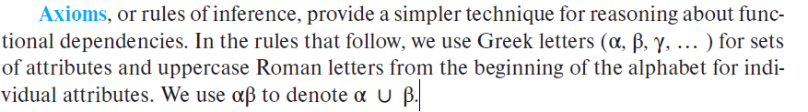
We can use the following three rules to find logically implied functional dependencies.
By applying these rules repeatedly, we can find all of F+, given F. This collection of rules is called Armstrong’s axioms in honor of the person who first proposed it.

Slide 26
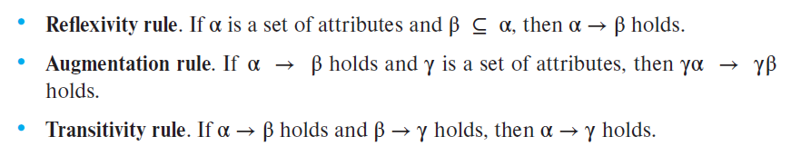
Armstrong’s axioms are sound, because they do not generate any incorrect functional dependencies. They are complete, because, for a given set F of functional dependencies, they allow us to generate all F+.

Slide 27
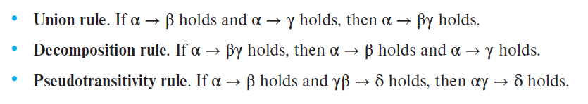
ADDITIONAL RULES

Slide 28
PROCEDURE TO COMPUTE F+
F+ = F
apply the reflexivity rule /* Generates all trivial dependencies */
repeat
for each functional dependency f in F+
apply the augmentation rule on f
add the resulting functional dependencies to F+
for each pair of functional dependencies f1 and f2 in F+
if f1 and f2 can be combined using transitivity
add the resulting functional dependency to F+
until F+ does not change any further

Slide 29
EXAMPLE
For relation R = (A, B, C, G, H, I) and the set F of functional dependencies {A → B, A → C, CG → H, CG → I , B → H}. Find out the closure of functional dependency.
A → H. Since A → B and B → H hold, we apply the transitivity rule.
CG → HI. Since CG → H and CG → I, the union rule implies that CG → HI.
AG → I. Since A → C and CG → I , the pseudo transitivity rule implies that AG → I holds.
Another way of finding that AG → I holds is as follows: We use the augmentation rule on A → C to infer AG → CG. Applying the transitivity rule to this dependency and CG → I, we infer AG → I .

Slide 30
Closure of attributes
Closure of an Attribute can be defined as a set of attributes that can be functionally determined from it.
Closure of a set of attributes X concerning F is the set X+ of all attributes that are functionally determined by X

Slide 31
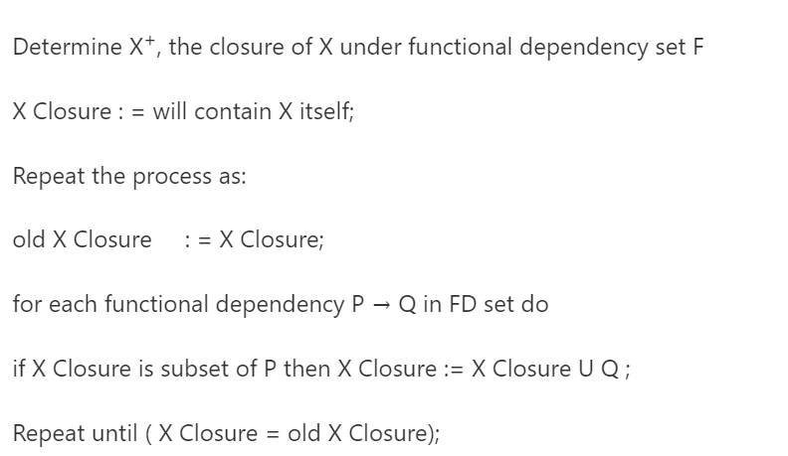
PSEUDOCODE TO FIND THE CLOSURE OF ATTRIBUTE

Slide 32
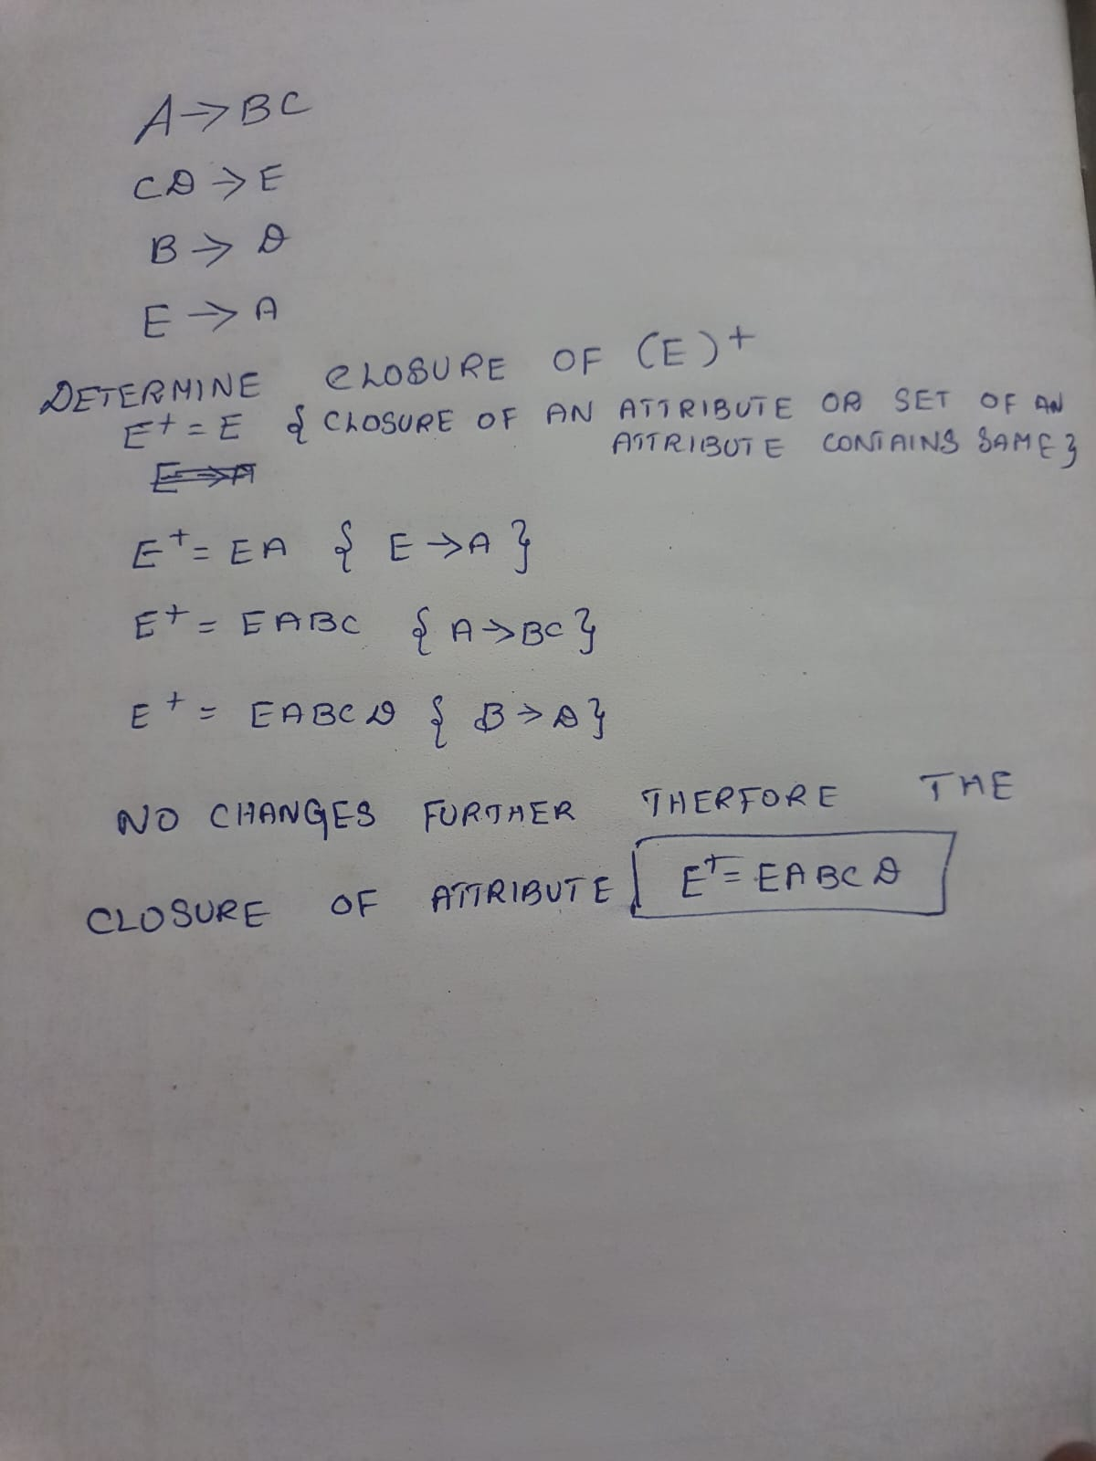
EXAMPLE
Given Relational schema R(A,B,C,D,E) with the given FDs find the closure of an attribute ‘E’.

Slide 33
Irreducible a set of functional dependencies (or)Canonical Cover
A canonical cover or irreducible a set of functional dependencies FD is a simplified set of FD that has a similar closure as the original set FD.
Extraneous attributes
An attribute of an FD is said to be extraneous if we can remove it without changing the closure of the set of FD.

Slide 34
PROCEDURE TO COMPUTE CANONICAL COVER
Fc = F
repeat
Use the union rule to replace any dependencies in Fc of the form
α1 → β1 and α1 → β2 with α1 → β1 β2.
Find a functional dependency α → β in Fc with an extraneous
attribute either in α or in β.
/* Note: the test for extraneous attributes is done using Fc, not F */
If an extraneous attribute is found, delete it from α → β in Fc.
until (Fc does not change)

Slide 35
A canonical cover Fc for F is a set of dependencies such that F logically implies all dependencies in Fc, and Fc logically implies all dependencies in F. Furthermore, Fc must have the following properties:
No functional dependency in Fc contains an extraneous attribute.
Each left side of a functional dependency in Fc is unique. That is, there are no two
dependencies α1 → β1 and α2 → β2 in Fc such that α1 = α2

Slide 36
Normalization
Database Normalization is the technique of organizing data into more than one table in the database.
It is a systematic approach of decomposing tables to eliminate data redundancy and undesirable characteristic like insertion, updation and deletion anomalies.
It is a multi-step process that puts data into tabular form, removing duplicated data from the relation tables.

Slide 37
Two Main Reasons
It eliminate redundancy data
It ensure data dependency makes sense.

Slide 38
Problem without Normalization
Without normalization it becomes difficult to handle and update database without facing data loss.
Insertion, updation and deletion anomalies are very frequent if the database is not normalized.

Slide 39
Anomalies
Insertion Anomaly: Insertion Anomaly refers to when one cannot insert a new tuple into a relationship due to lack of data.
Deletion Anomaly: The delete anomaly refers to the situation where the deletion of data results in the unintended loss of some other important data.
Updation Anomaly: The update anomaly is when an update of a single data value requires multiple rows of data to be updated.

Slide 40
S_id | S_name | S_address | Subject
401 | Adam | Noida | Biology
402 | Alex | Panipat | Maths
403 | Stuart | Jammu | Maths
404 | Adam | Noida | Physics
Updation Anomaly: To update address of student to occurs twice (or) more than twice in a table we have to update address column in all the rows else the data will come inconsistent.
Insertion Anomaly: Suppose for a student new admission, we have s_id, s_name, s_address of a student but the student has not opted for any subject then we have to insert null for the subject which leads to insertion anomalies.
Deletion Anomaly: If s_id = 401 has only one subject and temporarily drop it when we delete that row entire student record will be deleted along with it.

Slide 41
NORMAL FORMS
The term Normalization comes from the concept of normal form which describe how to organize the data in the database.
Normal Forms were developed around the concept of table based on relational database.

Slide 42
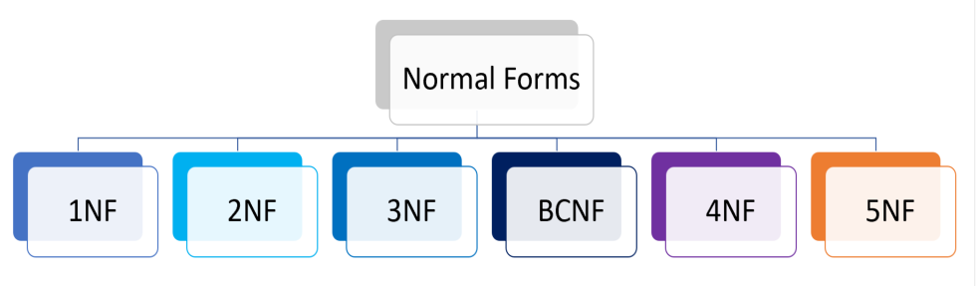
Types
1NF (First Normal Form)
2NF (Second Normal Form)
3NF (Third Normal Form)
BCNF (Boyce-Codd Normal Form)
4NF (Fourth Normal Form)
5NF (Fifth Normal Form)

Slide 43
UN-NORMALIZED FORM
If a table contains one or more repeating groups it is called Un-Normalized form.
Course | Content
Programming | C, Java, Python
Web | HTML, ASP, PHP

Slide 44
FIRST NORMAL FORM (1NF)
A relation is said to be in First Normal Form
If and only if all the attributes of relation are atomic (Single valued) in nature.
Must not contain any multi valued (or) composite attributes.
Course | Content
Programming | C, Java, Python
Web | HTML, ASP, PHP

Slide 45
This relation consists of multi-values. Hence it is not in first normal form.
The multi-values are eliminated and are written separately for each name (i.e.) multi-values are written atomic.
The table look like, after normalizing,
This 1NF allows data redundancy and there will be many column with same data in multiple rows but each row as a whole will be unique.
It is used in most small to medium application.
Course | Content
Programming | C
Programming | Java
Programming | Python
Web | HTML
Web | ASP
Web | PHP
Course | Content
Programming | C, Java, Python
Web | HTML, ASP, PHP

Slide 46
SECOND NORMAL FORM (2NF)
A relation is said to be in Second Normal Form,
If and only if it is already in First Normal Form.
There exist no Partial Dependency.
Partial Dependency:
It means that a non-prime attribute is functionally dependent on part of a prime attribute.
Functional Dependency:
All the non key attributes are fully functional depends on key attribute.

Slide 47
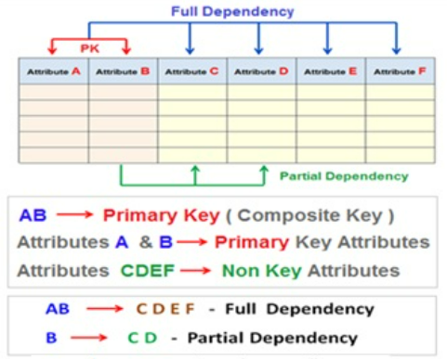
‹#›

Slide 48
To eliminate Partial Dependency
Create a new relation for each primary key attributed that is a determinant in partial dependency.
Move non-key attributes that are depend on primary key attributes from old relation to new relation.

Slide 49
Emp_id | E_name | Month | Sales | B_id | B_name
E1 | AA | Jan | 1000 | B1 | SBI
E1 | AA | Feb | 1200 | B1 | SBI
E2 | BB | Jan | 2200 | B2 | UBI
E2 | BB | Feb | 2500 | B2 | UBI
E3 | CC | Jan | 1700 | B1 | SBI
E3 | CC | Feb | 1800 | B1 | SBI
In the example, Emp_id is a primary key.
All the non-prime attributes depends on the Emp_id.
But B_name depends on B_id which is not in 2NF.
So this table is in 1NF but not in 2NF.
After removing the position into another relation store the lesser amount of data in two relations without the loss of data.

Slide 50
Example Table
Emp_id | E_name | Month | Sales | B_id | B_name
E1 | AA | Jan | 1000 | B1 | SBI
E1 | AA | Feb | 1200 | B1 | SBI
E2 | BB | Jan | 2200 | B2 | UBI
E2 | BB | Feb | 2500 | B2 | UBI
E3 | CC | Jan | 1700 | B1 | SBI
E3 | CC | Feb | 1800 | B1 | SBI
Table 1
Table 2
Emp_id | E_name | Month | Sales | B_id
E1 | AA | Jan | 1000 | B1
E1 | AA | Feb | 1200 | B1
E2 | BB | Jan | 2200 | B2
E2 | BB | Feb | 2500 | B2
E3 | CC | Jan | 1700 | B1
E3 | CC | Feb | 1800 | B1
B_id | B_name
B1 | SBI
B2 | UBI

Slide 51
Transitive Dependency
A->B (B depends on A)
B->C
A->C
The derived dependency is called transitive dependency when such dependency becomes improbable (i.e.) non-prime attribute depends on another non-prime attribute.
Eg:
Rollno->marks
Marks->grade
Rollno->grade

Slide 52
To eliminate Transitive Dependency
For each non-key attribute that is determinant in relation, create a new relation that attribute becomes a primary key in new relation.
Move all of the attribute that are functionally dependent on attribute from old relation into new relation.
Leave the attribute (which serve as primary key in new relation) in old relation to serve as a foreign key.

Slide 53
S_id | S_name | City | Pincode
1 | Shiva | Chennai | 15
2 | Peter | Pondy | 17
3 | Meera | Villupuram | 20
4 | Rohan | Delhi | 01
5 | Shakthi | Bangalore | 18

Slide 54
Example Table
S_id | S_name | City | Pincode
1 | Shiva | Chennai | 15
2 | Peter | Pondy | 17
3 | Meera | Villupuram | 20
4 | Rohan | Delhi | 01
5 | Shakthi | Bangalore | 18
Table 1
Table 2
S_id | S_name | Pincode
1 | Shiva | 15
2 | Peter | 17
3 | Meera | 20
4 | Rohan | 01
5 | Shakthi | 18
Pincode | City
15 | Chennai
17 | Pondy
20 | Villupuram
01 | Delhi
18 | Bangalore

Slide 55
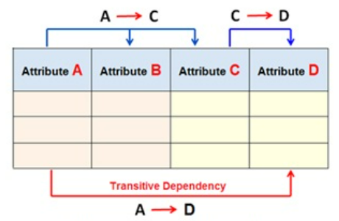
THIRD NORMAL FORM (3NF)
A relation is said to be in Third Normal Form if and only if,
It is already in Second Normal Form.
There exist no Transitive Dependency.

Slide 56

Fourth Normal Form (4NF)
Functional dependencies can help us detect poor E-R design
multivalued dependency arises from one of the following sources:
• A many-to-many relationship set.
• A multivalued attribute of an entity set.
A relation schema (R) is in fourth normal form(4NF)with respect to a set D of functional and multivalued dependencies if, for all multivalued dependencies in D of the form A→→B, where A⊆R and B ⊆R, at least one of the following holds:
• A→→B is a trivial multivalued dependency.
• A is a super key for R.

Slide 57
4NF
A table is said to be in 4NF if the following conditions are met,
The table is in Boyce-Codd Normal Form (BCNF).
The table is not any having an independent multi-valued dependency.

Slide 58
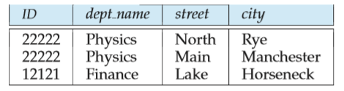

What is a Multivalued Dependency?
A full constraint between two sets of attributes in a relation.
Multivalued dependency would occur whenever two separate attributes in a given table happen to be independent of each other. And yet, both of these depend on another third attribute. The multivalued dependency contains at least two of the attributes dependent on the third attribute.
ID →→ street, city
ID→→dept name is a non-trivial multivalued dependency and ID is not a superkey for the schema.

Slide 59
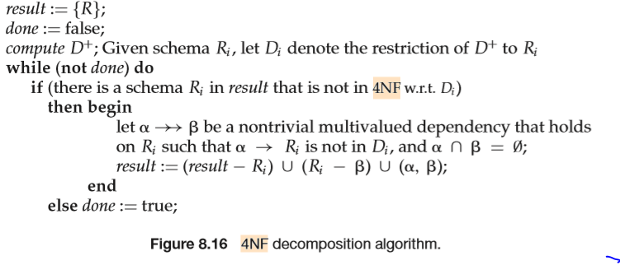
4NF DECOMPOSITION ALGORITHM

Slide 60

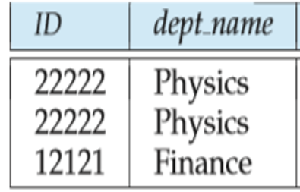
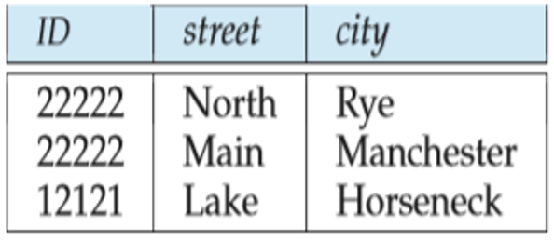
Lossless-join Decomposition
A decomposition of R into R1 and R2 is a lossless join if at least one of the following dependencies is in D+
And lossless if R1 U R2=D+
ID→→dept_name is a non-trivial multivalued dependency, and ID is not a superkey for the schema.
Following the algorithm,we replace it by two schemas:
r1 (ID, dept name) r2 (ID, street, city)

Slide 61
Join dependency and 5 NF
5NF is also called project join normal form(PJNF)
It is based on lossless join decomposition.
A relation is said to be in 5NF
if and only if it satisfies 4NF and no join dependency exists.
A relation is said to have join dependency if it can be recreated by joining multiple sub relations and each of these sub-relations has a subset of the attributes of the original relation.

Slide 62
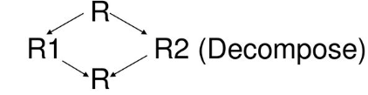
Condition for join dependency
Consider a relation R(P,Q,S) .
where R1 and R2 are the decompositions such that
R1 (P, Q) and R2 (Q, S)
Then R1 and R2 are a lossless decomposition of R if R can be obtained by joining R1 and R2.

Slide 63
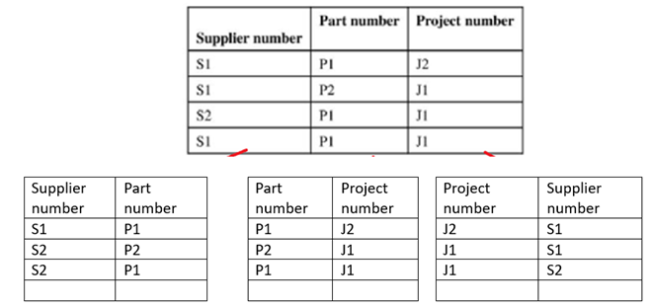
P1
P2
P3

Slide 64
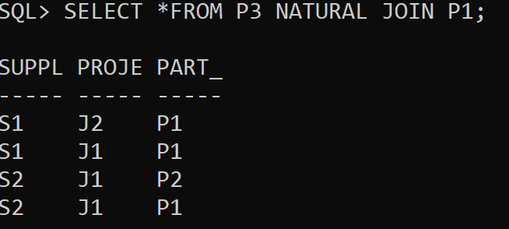
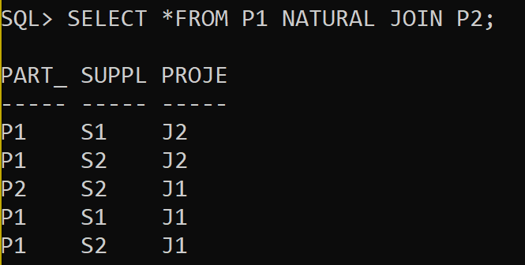
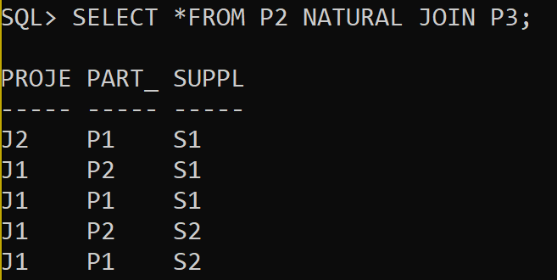
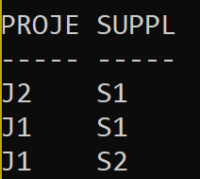
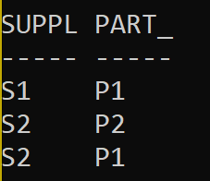
SO THE TABLE TO SATISFY 5NF IS PARTITIONED INTO P3 AND P1 since the natural join does not generate any additional rows

Slide 65
Normal Form
1NF A relation is in 1NF if it contains an atomic value.
2NF A relation will be in 2NF if it is in 1NF and all non-key attributes are fully functional dependent on the primary key.
3NF A relation will be in 3NF if it is in 2NF and no transition dependency exists.
BCNF A stronger definition of 3NF & on the left-hand side of the functional dependency there is a candidate key
4NF A relation will be in 4NF if it is in Boyce Codd's normal form and has no multi-valued dependency.
5NF A relation is in 5NF. If it is in 4NF and does not contain any join dependency, joining should be lossless.

Slide 66
THANK YOU

